Slide 1
Welcome to the adventure of Cub Scouting!

Slide 2
DEN & PACK INFORMATION
My Scout is in Pack:
Meeting location:
Meeting dates:
Meeting time:
Den Leader:
Phone Number:
Email:
Cubmaster:
Phone Number:
Email:

Slide 3
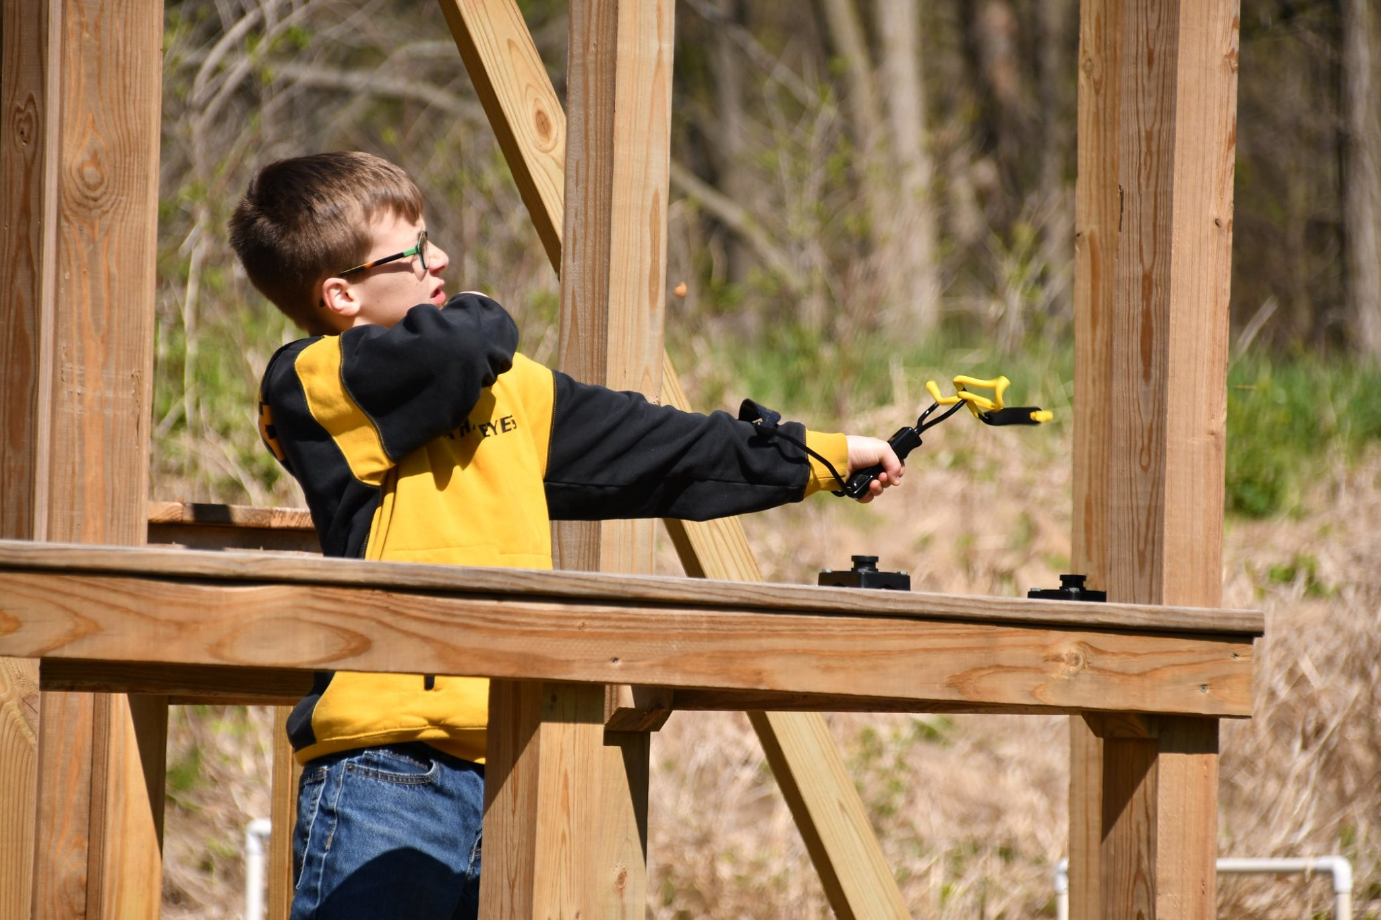
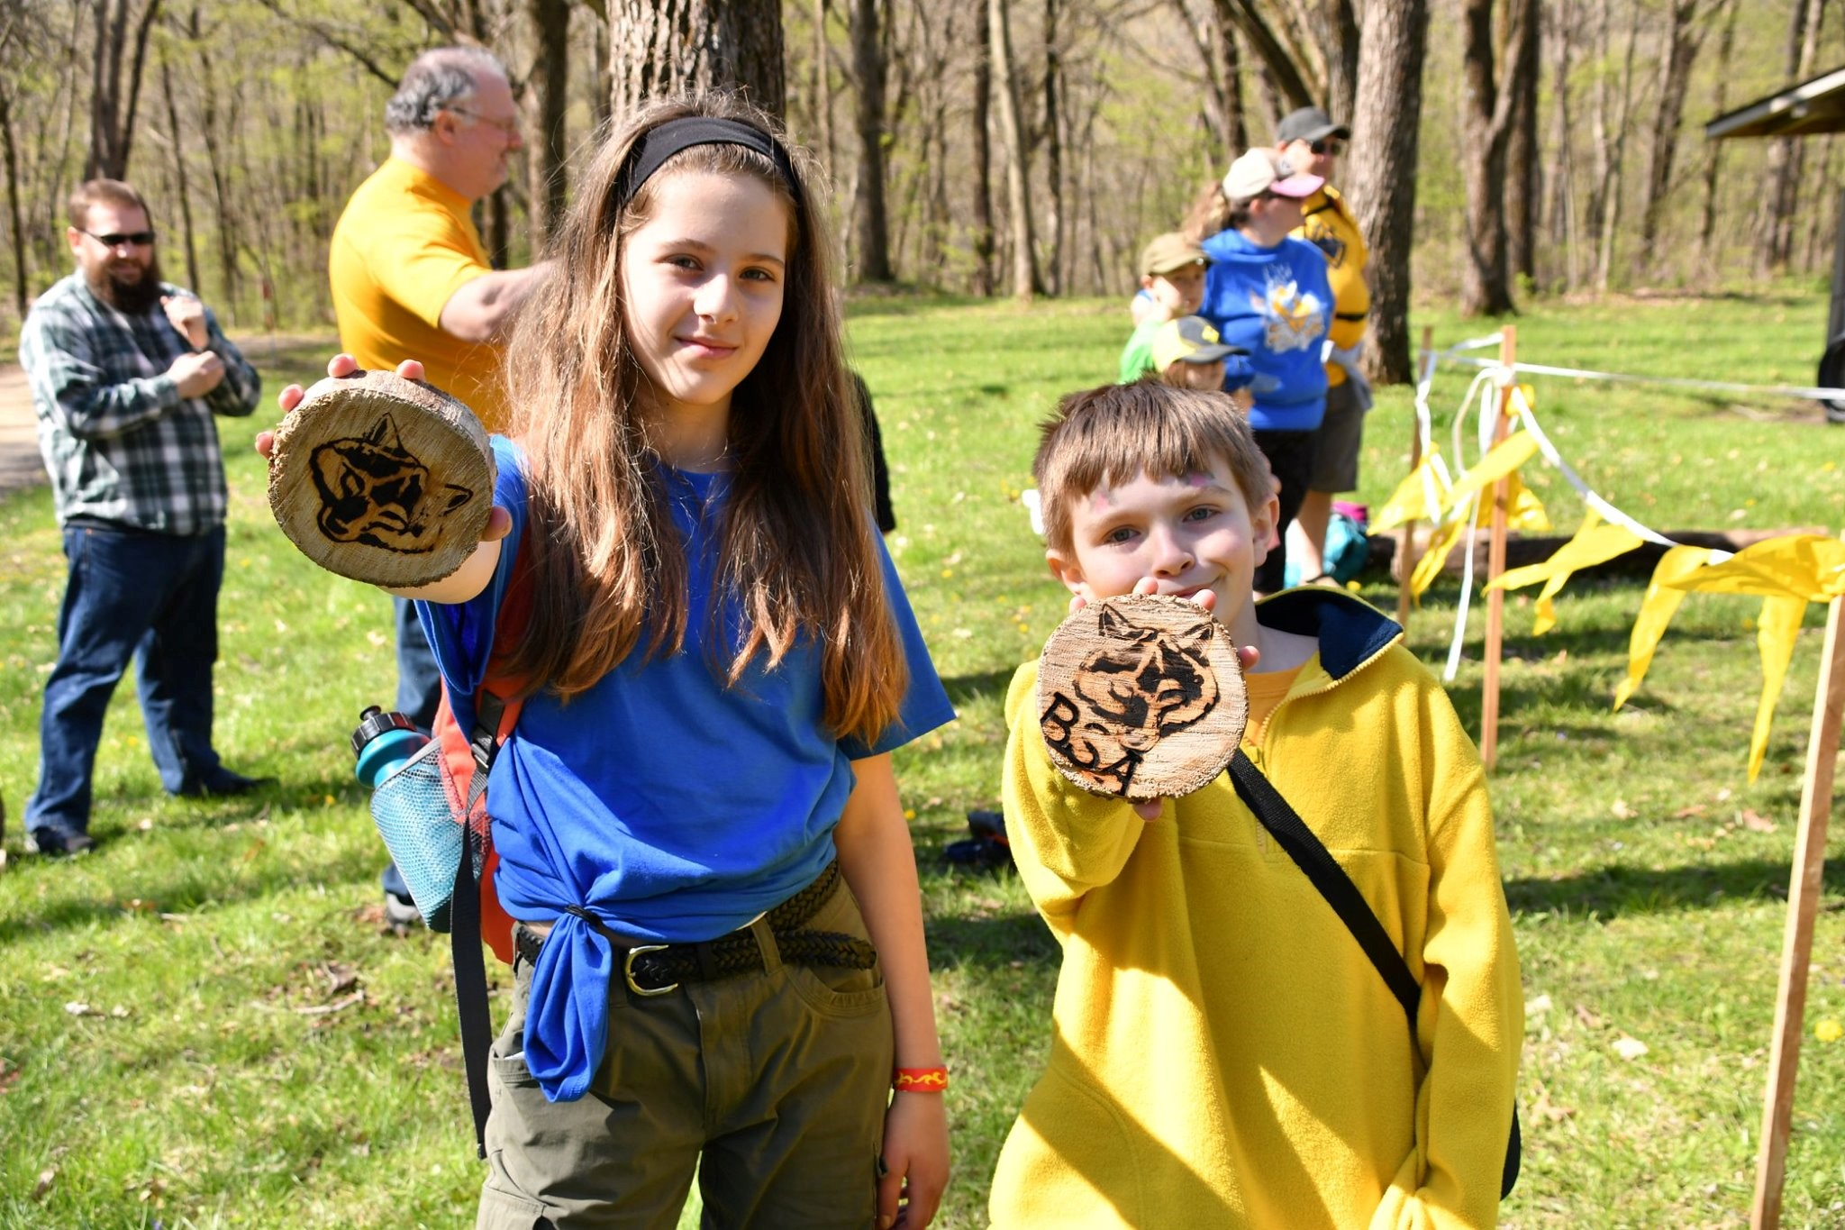
CUB SCOUTING…
Nurtures leadership and character growth
Strengthens family
Helps boys and girls develop interests and skills
Provides adventure
Creates fellowship
Promotes diversity
Teaches duty to God and Country
Is FUN!

Slide 4
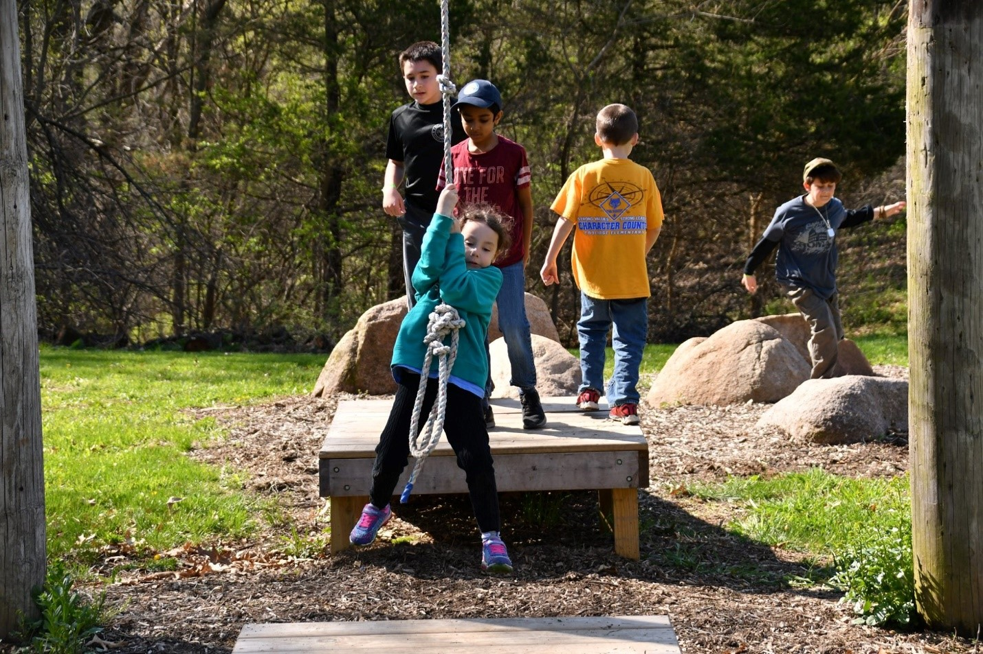
Cub Scouts are at that magical age where everything is new and possible and, most important fun. They build things. Play with purpose. Make friends and work together. The life lessons learned here not only transform today’s Cub Scouts into tomorrows Scouts BSA members but also help form a foundation to embrace and overcome obstacles in life.

Slide 5
What are the top five questions new parents had about Cub Scouting when they first joined?

Slide 6
Questions #1
What uniform and handbook will we need and where do I get them?

Slide 7
Uniform for meetings: - Shirt and neckerchief Optional: - Hat, belt, socks

Slide 8
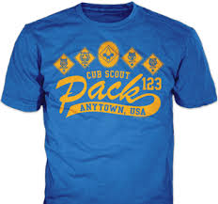
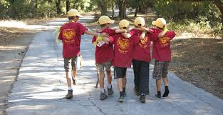
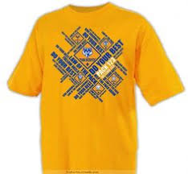
T-Shirts are worn for outdoor activities

Slide 9
All Cub Scouts need a Handbook
Handbooks are used to record Cub Scout activities

Slide 10
Hawkeye Area Scout Shop 660 32nd Ave. SW Cedar Rapids Scout Shop Hours: Monday, Wednesday, Thursday, Friday: 8:30 AM – 6:00 PM Tuesday: 8:30 AM – 7:00 PM Saturday: 9:00 AM – 3:00 PM

Slide 11
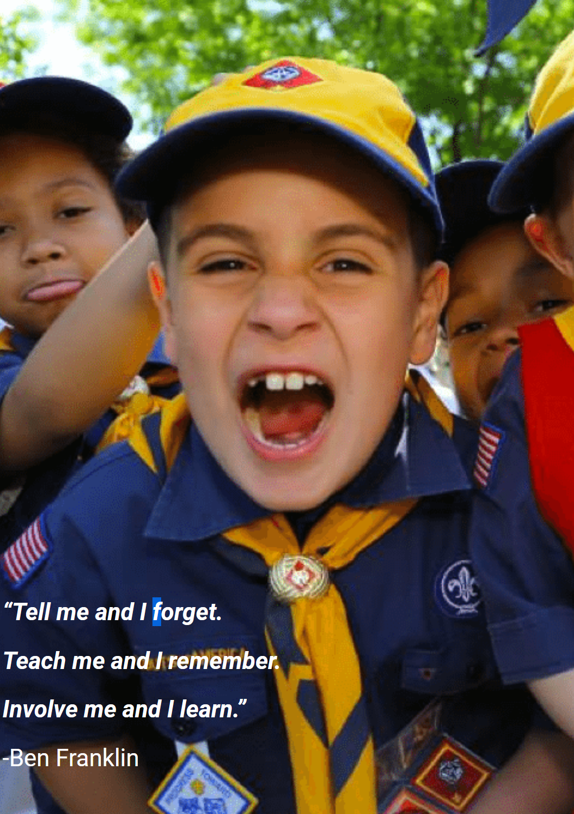
Questions #2
What is a den?

Slide 12
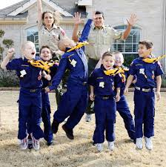
Dens are a small groups broken down by grade and gender. Each den is led by an adult den leader in addition to other parents, together they plan and carry out a year-round program of activities for the den.
While the meetings include games and other activities that are fun for the Scouts, program delivery is the main goal. Scouts participate in activities and work on projects that are related to an adventure and that help them learn the skills they need to progress in rank.
Most den meetings are held twice a month but the frequency of meetings is up to the den leader and the families in the den. On average a den meeting lasts about an hour with some lasting longer based on the size of the den and the activity planned.
When and where the den meets is also up to the den leader and the families in the den. Some may already have an established meeting location provided by the chartered partner or it the den may meet at one of the families home.

Slide 13
Questions #3
What is a pack?

Slide 14
A pack is made up of multiple dens. The dens get together monthly for a pack meeting which brings together Scouts from every den, their leaders, and families for a large-scale event that showcases all that the Scouts have learned and done in their individual den meetings.
The highlight of the pack meeting is the formal recognition given to the Scouts who have earned badges, adventure loops, or other awards, and to leaders who may have earned training awards or deserve special recognition. This is followed by some general announcements and a formal closing ceremony to end the meeting.
The families in the pack may choose to organize and get together for special pack activities. The most common pack activities include the Pinewood Derby, Blue and Gold Banquet, and Pack Overnighters.

Slide 15
PACK ORGANIZATION
SCOUTS
DEN LEADERS
CUBMASTER
WEBELOS LEADERS
Assistant
Assistant
Assistant
Pack Committee
COMMITTEE CHAIR
Chartered Partner
Hawkeye Area Council, Boy Scouts of America

Slide 16
Questions #4
What is a rank advancement and how does it work?

Slide 17
Cub Scout activities are centered around earning badges. On the advancement trail, a Cub Scout progresses towards a badge of rank based on their grade. They need not have earned the previous rank in order to earn the next. Each of the ranks in Cub Scouting has its own requirements that are age appropriate, so earning a rank below a Cub Scout’s current grade is not permitted. As a Cub Scout advances through the ranks, the requirements get more challenging, to match the new skills and abilities they have learned.
All of the activities for each rank are in the Cub Scout handbooks.

Slide 18
Questions #5
Who is Akela?

Slide 19
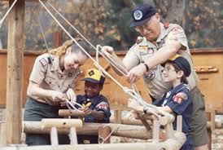
In Cub Scout packs, Akela is a symbol of wisdom, authority, and leadership. Akela is anyone who acts as a leader to the Scout. Akela can be a Cubmaster, Den Leader, parent or teacher depending on where the guidance takes place.
In den meetings, it is the Den Leader who is Akela. During pack meetings it is the Cubmaster. At home, the parents fill this role.

Slide 20
AIMS AND METHODS OF CUB SCOUTING
The mission of the Boy Scouts of America is to prepare young people to make ethical and moral choices over their lifetimes by instilling in them the values of the Scout Oath and Law.
There are four aims of Scouting: citizenship, character, personal fitness, and leadership.
The methods of Cub Scouting are: living the ideals, belonging to a den, advancement, family involvement, activities, serving the community, and the uniform.

Slide 21
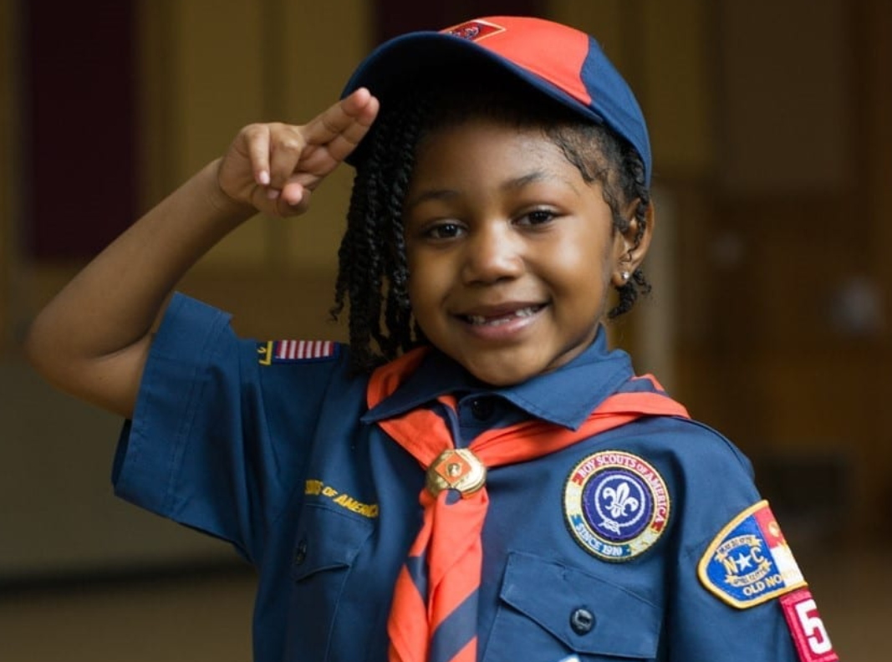
Living the ideals
Cub Scouting’s values are embedded in the Scout Oath, the Scout Law, the Cub Scout motto, and the Cub Scout sign, handshake, and salute. These practices help establish and reinforce the program’s values in Scouts and the leaders who guide them.

Slide 22
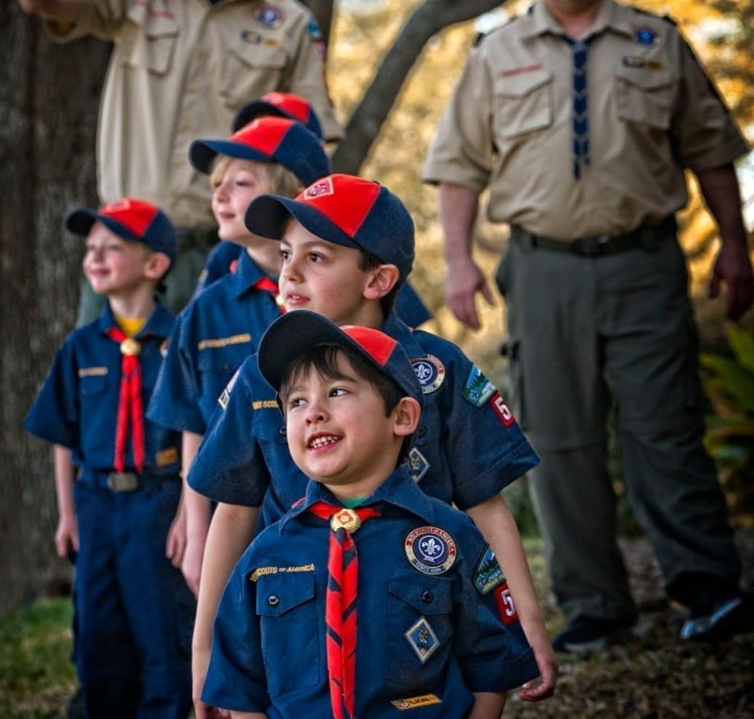
Belonging to a den
The den—a group of six to eight children who are in the same grade and are the same gender—is the place where Cub Scouting starts. In the den, Cub Scouts develop new skills and interests, they practice sportsmanship and good citizenship, and they learn to do their best, not just for themselves but for the den as well.

Slide 23
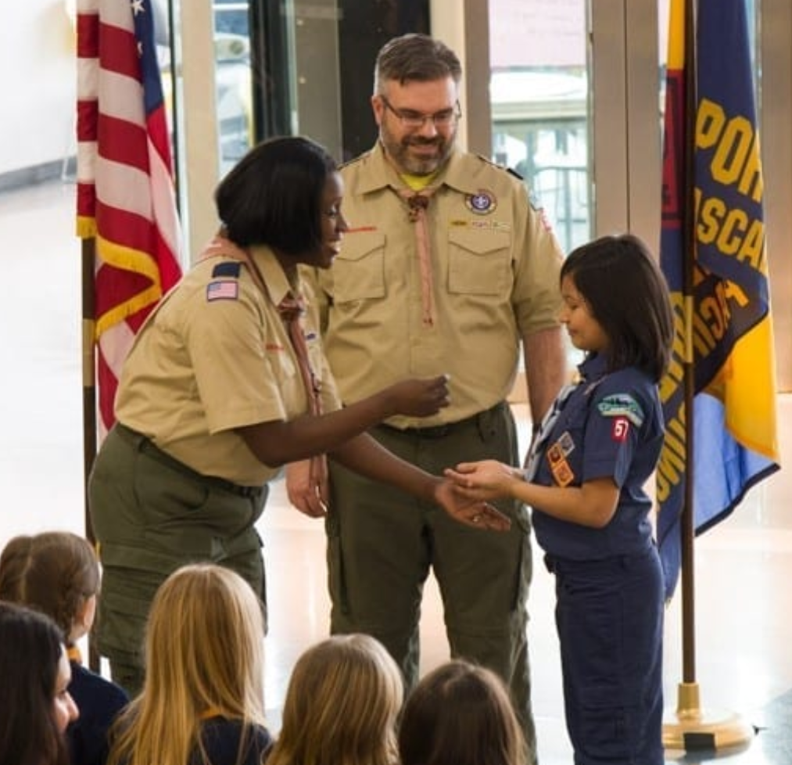
Advancement
Recognition is important to everyone. The advancement plan provides fun for the Scouts, gives them a sense of personal achievement as they earn badges, and strengthens family understanding as adult family members and their den leader work with them on advancement projects.

Slide 24
ADVANCEMENT
Age based rank
Assigned by grade
Adventures
Connecting effort & success
Recognition
Celebrating achievement and building self-confidence

Slide 25
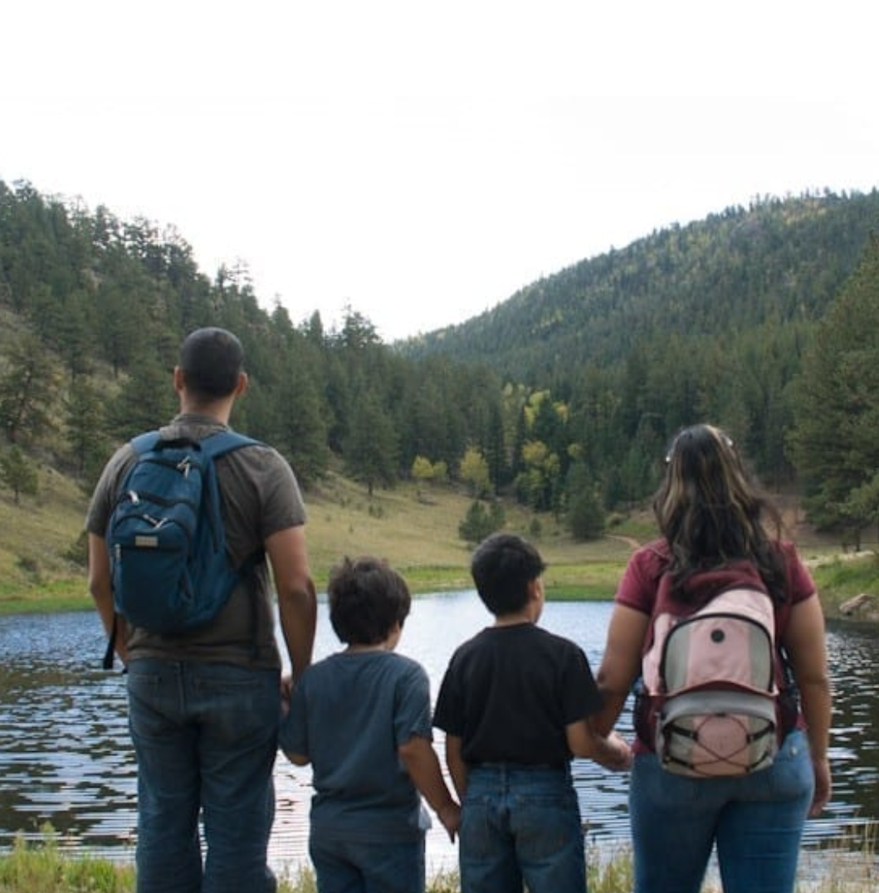
Family Involvement
Whether a Cub Scout lives with two parents or one, a foster family, or other relatives, their family is an important part of Cub Scouting. Parents and adult family members provide leadership and support for Cub Scouting and help ensure that Scouts have a good experience in the program.

Slide 26
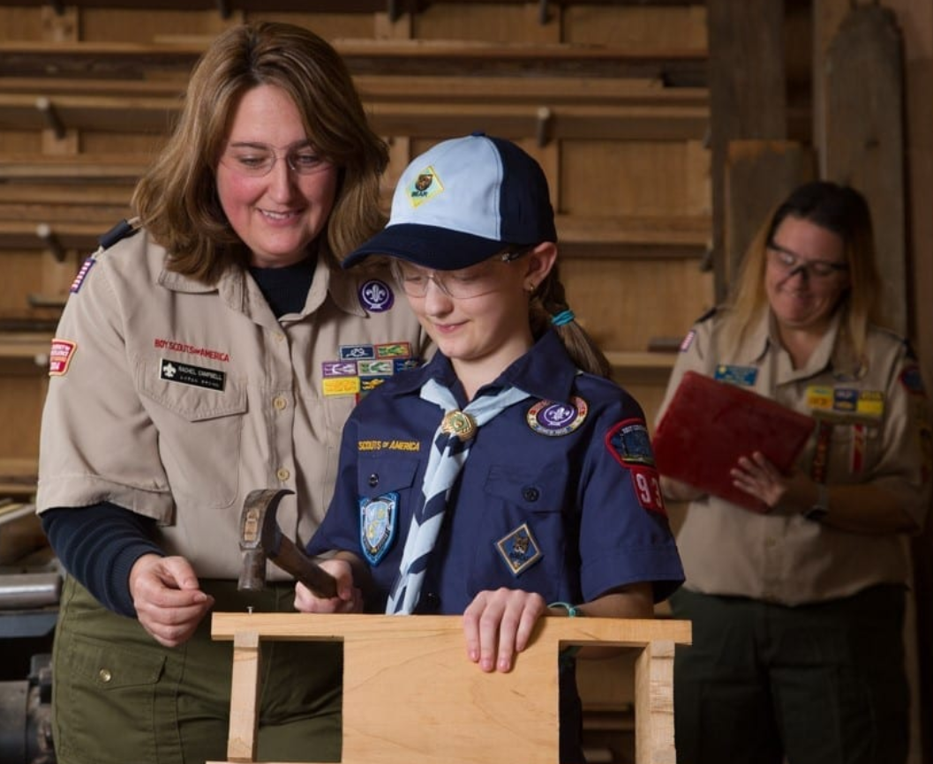
Activities
Cub Scouts participate in a huge array of activities, including games, projects, skits, stunts, songs, outdoor activities, trips, and service projects. Besides being fun, these activities offer opportunities for growth, achievement, and family involvement.

Slide 27
SCOUTING ACTIVITIES
Fall Cub Scout Family Camporee
Community Service – Scouting for Food
Day Camp
Pinewood Derby
Scout Nights with the Kernels and RoughRiders
Blue and Gold Banquet
And so many more Adventures!

Slide 28
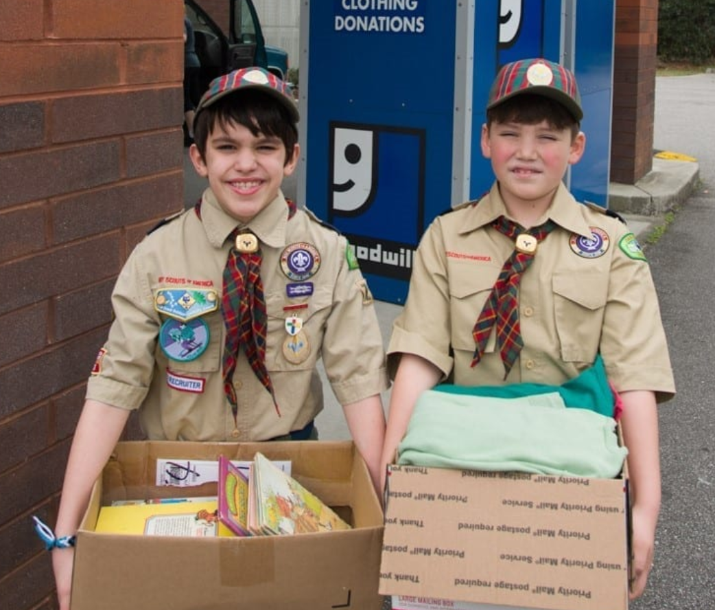
Serving the community
Cub Scouting focuses on the home and neighborhood. It helps Scouts strengthen connections to their local communities, which in turn supports their growth and development.

Slide 29
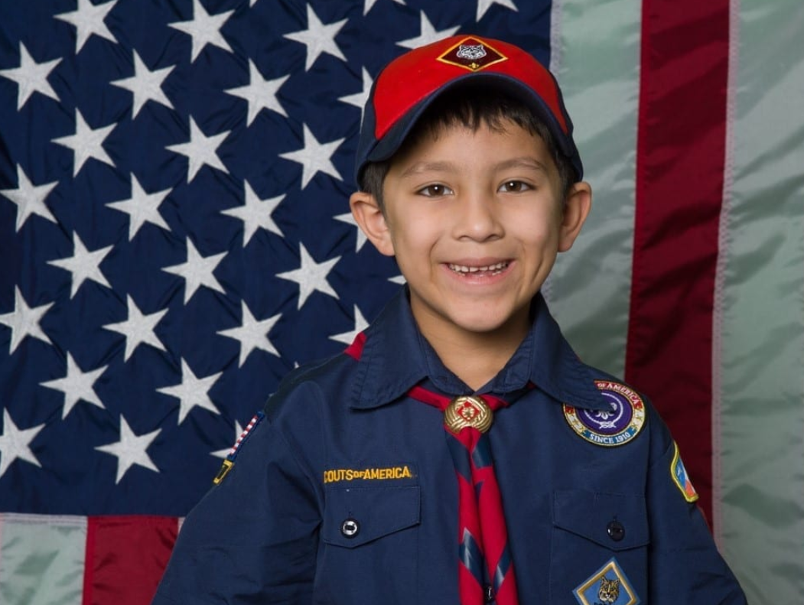
Uniform
Cub Scout uniforms serve a dual purpose, demonstrating that a Scout is part of a team and showing individual achievement (Scouts wear the badges they’ve earned). Wearing the uniform to meetings and activities also encourages a neat appearance, and good behavior.

Slide 30
Cost of Cub Scouting
When compared to the cost of sports and many other activities, there is no doubt that Scouting delivers great value to its members! The registration fee to join Scouting is $33 annually. In addition, there are uniform costs and nominal activity fees that may be charged by your local unit. Of course, these costs may be offset by unit fundraising and other available scholarship funds.

Slide 31
BSA Membership - The annual membership fee is $33 which covers 12 months of membership. For only $1 a month, $12 for the year, Cub Scouts may subscribe to Boys’ Life magazine. Cost of joining may vary based on the time of year when you join.
Uniform - The uniform is a method of delivering the Scouting program. It shows that you are a member of a team. Each grade has a specific uniform for their program.
Handbook - Each grade level has a specific handbook they use. Handbooks are about $17 and are used for the year. Handbooks have all the required and elective adventures for each rank. Handbooks also serve as a Scout’s record of completing adventures.
Dues - To cover the costs of awards and recognition, crafts, and special events most local packs have dues. Packs may offer opportunities to conduct fundraisers to offset these costs. Dues are established by the families in the pack through the pack committee.
Activities - Additional activities such as overnight camp outs, field trips, day camps and resident camps have additional costs associated with them. These costs differ based on several factors. Detailed information can be provided by the local pack leadership.

