Slide 1
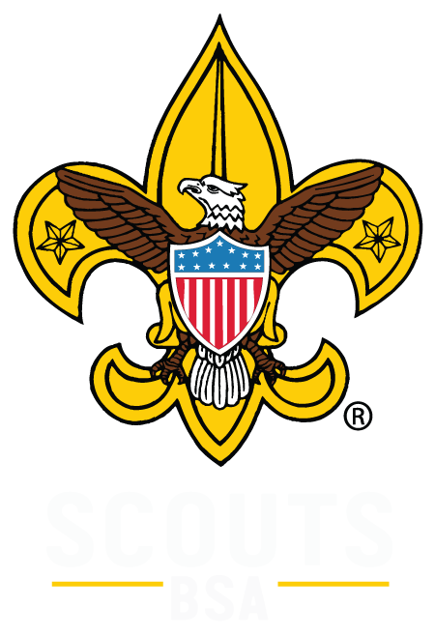
Jeopardy

Slide 2
History | Codes | First Aid | Camp Skills | Uniform | Knowledge
200 | 200 | 200 | 200 | 200 | 200
400 | 400 | 400 | 400 | 400 | 400
600 | 600 | 600 | 600 | 600 | 600
800 | 800 | 800 | 800 | 800 | 800
1000 | 1000 | 1000 | 1000 | 1000 | 1000

Slide 3
What year was the boy scout program released in America?
1910
Notes:
History 200

Slide 4
Where did boy scouts originate?
Brown Sea Island, England
Notes:
History 400

Slide 5
Who is the founder of Boy scouts?
Lord Baden Powell
Notes:
History 600

Slide 6
How many boy scout programs are there? Name 3
Cub scouts
Scouts. BSA
Explorers
Varsity
Venturing
Sea Scouts
Stem Scouts
Notes:
History 800

Slide 7
What year was scouting/USA used?
1971
Notes:
History 1000

Slide 8
Scout motto
Be Prepared
Notes:
Codes 200

Slide 9
Scout Law
A Scout is trustworthy, loyal, helpful ,friendly, courteous, kind, obedient, cheerful, thrifty, brave, clean, and revenant.
Notes:
codes 400

Slide 10
Scout oath
On my honor
I will do my best
To do my duty
To god and my country
To keep myself physically strong
Mentally awake and mortally straight
Notes:
codes 600

Slide 11
How do you the scout handshake?
Extend your left hand to another scout and firmly grasp their left hand. Made with the hand nearest to your heart, the Scout handshake signifies friendship.
Notes:
Codes 800

Slide 12
Outdoor code
As an American, I will do my best to –
Be clean in my outdoor manners.
Be careful with fire. Be considerate in the outdoors.
Be conservation - minded.
Notes:
Codes1000

Slide 13
What is the first step after being cut?
Clean the wound
Notes:
First Aid 200

Slide 14
3 items in a personal first aid kit
Large and small band aids
Gauze pads
Small bar of soap or hand sanitizer
Triple antibiotic ointment
Scissors
Tweezers
Latex free gloves
Notes:
First Aid 400

Slide 15
What do you do when some is seriously injured?
Get an adult
make sure the injured party is out of danger.
Keep Calm
Notes:
First Aid 600

Slide 16
What are some ways to prevent ticks?
Hair up
Hats
Long pants
Non aerosol hairspray
Long Socks
Notes:
First Aid 800

Slide 17
3 signs a snake is poisonous…
Smells like cucumber
Shape of their head
Color of scales
Location of where they live
Pattern of scales
Notes:
First Aid 1000

Slide 18
What do you need when building a fire?
Wood
Bucket of water
Matches, flint, or lighter
Kindling
Fire starters or newspapers
Notes:
Camp Skills 200

Slide 19
When walking around what system should a scout be using?
Buddy system
Notes:
Camp skills 400

Slide 20
If you get lost at a campout, what do you do?
Stay put – It is easier for rescuers to find a stationary person than one who is moving. Find a place which is not hazardous and stay there. Have some water and a snack if possible. Rest.
Think – Consider what resources you have should the situation extend into overnight. Develop confidence by considering your situation and being prepared.
Observe – Take note of your surroundings. Is there shelter from the cold or storms? Is it getting dark? Are there hazards in the area?
Plan – Determine what you can to do to conserve energy and be as comfortable as possible. Don’t panic. Rely on your knowledge and observations.
Notes:
Camp Skills 600

Slide 21
Proper care of a rope
Whip and fuse
Notes:
Camp Skills 800

Slide 22
how far away do use a knife from the next person?
Your arm length, aka your Safety Circle or Blood Circle
Notes:
Camp Skills 1000

Slide 23
What part of the scout uniform holds your pants up?
BSA Belt and belt buckle
Notes:
Attire 200

Slide 24
What part of the scout uniform needs to be tucked in?
Field Uniform (Class A) and Activity Uniform ( Class B) Boy Scout uniform
Notes:
Attire 400

Slide 25
What are the colors of the scout pants?
Olive Green
Notes:
Attire 600

Slide 26
What should be clean and nicely trimmed?
Nails, Hair, and General Overall Appearance
Notes:
Attire 800

Slide 27
What is the most forgotten part of the scout uniform?
BSA Approved Socks
Notes:
Attire 1000

Slide 28
How do you sing?
You sing by standing up because singing comes from the knees.
Notes:
Knots 200

Slide 29
What is the patrol method?
A group of 5 to 7 scouts working together towards a common goal
Notes:
Knots 400

Slide 30
What does edge stand for?
Explain
Demonstrate
Guide
Enable
Notes:
Knots 600

Slide 31
Four steps of scout advancement ?
Learn
Tested
Reviewed
Recognized
Notes:
Knots 800

Slide 32
What are the three R’s of personal safety and protection?
Recognize
Respond
Report
Notes:
Knots 1000

Slide 33
What is the highest award in scouting in Canada and great Britain?
Queen’s scout badge equal to Eagle

Slide 34
What poisonous and/or dangerous snakes and spider live in our region?
Northern water snake
Brown recluse
Black widow
Timber Rattlesnake
Northern copperhead
Eastern Mississauga
Wolf spider

Slide 35
How do you end a campfire?
Scout Vespers

Slide 36
What are 3 weather signs or weather sayings ?
Red sky at night, sailors delight
Red sky at morning, sailor take warning
Swallows flying way up high in the sky, no rain in the sky
When there's dew on the grass, rain will never come to pass
When grass is dry as morning light, look for rain before the night.
Smoke goes high no rain comes by.
If smoke hangs low, look for a blow.
Mackerel scales and mares’ tails make lofty ships carry low sails

Slide 37
What does the world crest signify on your uniform?
Square knot- which symbolizes the unity and brotherhood of the movement throughout the world. Even as one cannot undo a reef knot no matter how hard one pulls on it, so, as it expands, the movement remains united.
The three tips of the center fleur-de-lis represent the three points of the Scout Promise. In some countries, the two decorative five-pointed stars stand for truth and knowledge.
The crest is white on a royal purple background. These colors are symbolic as well. In heraldry, white represents purity and royal purple denotes leadership and help given to other people.

Slide 38
How many countries have scouting programs?
Approximately 250 countries and Providences

